Slide 1
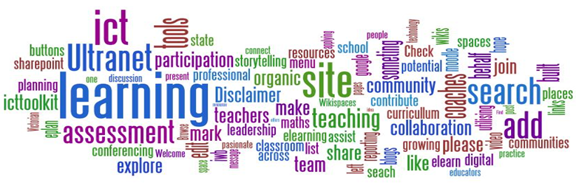
INFORMATION AND COMMUNICATION TECHNOLOGY– iGCSE
2015-16
0417
1.1 - Types of Components of Computer Systems

Slide 2
Assignment Scenario
There are 4 sections to this Theory Unit, each of which will give you a basic understanding and practice at possible exam questions. It will involve gaining knowledge towards the answers.
This is not a wrote learning course, you will need to understand the basics of ICT in order to adapt your knowledge towards companies and their needs. This will involve understanding Components of computer systems, Inputs and Outputs, Storage devices and media, Data Types, The Effects of Using ICT, The Ways in which ICT is used and Systems Analysis and Design.
In the exam you will be given a scenario to answers questions from, and adapt your knowledge and use the key terms and named components to give a judgemental answer.
The exam will consist of precise questions requiring precise answers as well as theory questions that will require you to propose a possible solution with a justification.

Slide 3
1 – Assessment Objectives
1 – Types and Components of Computer Systems
1.1 – Hardware and Software – What is in the box and how the software on the hard drive interacts with the hardware, and a host of input and output device
1.2 – Main Components of Computer Systems – Monitor, Base, Power Supply, Motherboard, CPU, Graphics Card, CD Drive, Keyboard, Mouse s.
1.3 - Operating Systems – The way we see the information on our computer when we switch it on, and how the computer fixes and protects our information.
1.4 – Types of Computers – Laptops, Base units, tablets, PDA’s, Sensor readers.
The Hardware changes that have happened in your lifetime The new technology due to come out The way gaming and PC’s have improved How more advanced your car dashboard is. What life was like before computers came along Would you miss your technology

Slide 4
1.1 – Hardware and Software
Outlines below are the objectives for this section of the Unit. They should be revised as part of the exam preparation.
Hardware – This is the general term for the physical components that make up a computer system, for example, keyboard monitor, processor, base unit etc. This also includes Tablets, Laptops and Phones. If you can touch it or hold it then it is hardware.
Hardware can be divided into 3 sections:
Input Devices – keyboard, mouse, touchpad, joystick, scanner
Output Devices – Monitor, printer, turtle.
Secondary Storage devices – CD, DVD, USB, External Hard Drive.
What is in the box in front of you Why some computers are slower than others Why a tablet has a different look and feel to a laptop. The USB memory stick you, how does the computer know it is there. What will be different in terms of hardware in ten years. Will a tablet replace a Laptop

Slide 5
1.2 – Main Components
What is in the box in front of you Why some computers are slower than others Why a tablet has a different look and feel to a laptop. The USB memory stick you, how does the computer know it is there. What will be different in terms of hardware in ten years. Will a tablet replace a Laptop
During the video write down the 7 main parts

Slide 6
1.1 – Hardware and Software - Software
Outlines below are the objectives for this section of the Unit. They should be revised as part of the exam preparation.
Software – The software on a computer comes in a variety of types and each has a function and is installed on the machine for later use. Similar to Apps:
Utility Software – These are programs that benefit the machine, help repair it, protect it, or manipulate the hardware for the benefit of the user such as virus Checkers, File Converters, File Management, Network support etc.
Word processing Software – These process documents from scratch or through editing such as Word, Open Office, Notepad, Write or Word Perfect.
Spreadsheet Software – These manipulate numeric data using formulas and graphs and present that information in a managed way.
What is in the box in front of you Why some computers are slower than others Why a tablet has a different look and feel to a laptop. The USB memory stick you, how does the computer know it is there. What will be different in terms of hardware in ten years. Will a tablet replace a Laptop

Slide 7
1.1 – Hardware and Software - Software
Outlines below are the objectives for this section of the Unit. They should be revised as part of the exam preparation.
Graphic Software – These create, retrieve or manipulate images in 2D or 3D and output them for printing like Photoshop, Maya, CAD.
Database Software – Similar to spreadsheets these manipulate data for output such as school records or ticket sales. Examples include Access or Sims.
Presentation Software – These present information for the user like this PPT.
Video and Sound Software – These manipulate, retrieve and process video and sound through techniques like MovieMaker, iMovie or After effects.
Other Software – For every computer based purpose there is a piece of software for it, game making, CAD, printing, scanning, control software for greenhouses etc.
What is in the box in front of you Why some computers are slower than others Why a tablet has a different look and feel to a laptop. The USB memory stick you, how does the computer know it is there. What will be different in terms of hardware in ten years. Will a tablet replace a Laptop

Slide 8
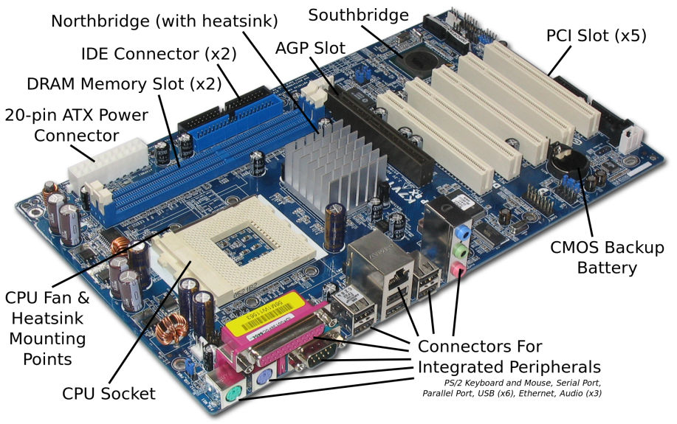
1.1 – Hardware and Software - Overall
There are 8 main parts of a computer
Motherboard – This is the main component inside all computers and is a base for all the other components to connect to. It is complimented by the CPU. There are lots of technical things about Motherboards you could look up such as Bridges, Models, Connectors and Speed.
All processes link through the Motherboard which holds the memory (RAM and ROM) to move information to and from the CPU.
Though they look complex, most motherboards are set up in a similar way.
What is in the box in front of you Why some computers are slower than others Why a tablet has a different look and feel to a laptop. The USB memory stick you, how does the computer know it is there. What will be different in terms of hardware in ten years. Will a tablet replace a Laptop
Motherboard | CPU | Video Card | RAM
Power Supply | Hard Disk | Optical Drive | BIOS

Slide 9
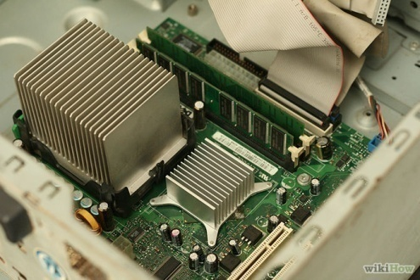
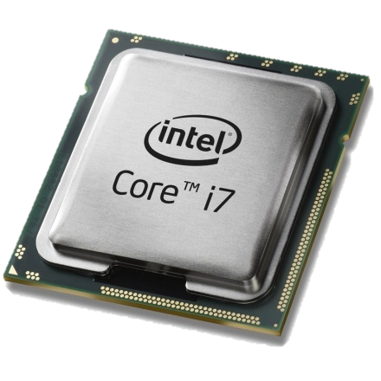
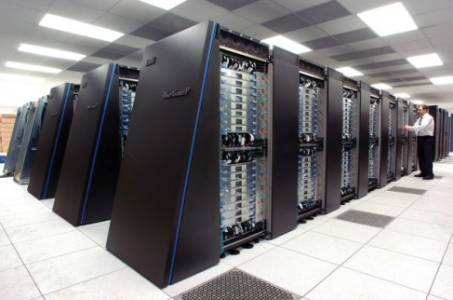
1.2 – Main Components - CPU
CPU – This is the brain of the computer whereas the motherboard is the heart. This does all the thinking (Processing) and takes information from the inputs (Keyboards, mouse, scanner etc.), processes the information (thinks about the commands given and reproduces them into binary instructional codes) and then outputs the processing to the output devices (screen, printer, GPU)
The rule is: The faster the CPU, the faster the machine can process instructions. This is why it is the most expensive component within the computer and the most important.
There are different kinds, Intel with its Core and Xeon range, Celeron and AMD are the 3 main manufacturers.
All computers, mainframes, tablets and phones have one of these at the heart of the machine.
Task 1 – In 2 minutes, find out and show the teacher what CPU the machine in front of you is using right now and tell the teacher whether you think it is a good version or not.

Slide 10
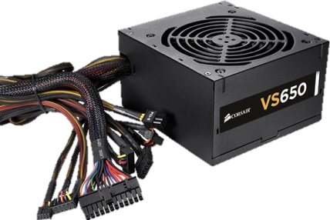
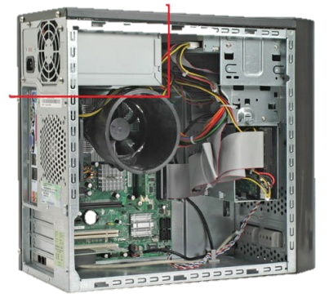
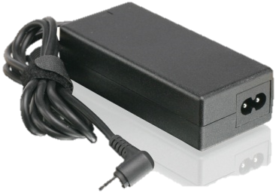
1.2 – Main Components – Power Supply
Power Supply – There are several types of power supply, depending on the computer. Most bases have the large volt supply that comes with the connector cables for the majority of computer components. It has a fan because of the heat generated and a plug socket.
For Laptops they will have their own unique supply, a small box with a lead and connector but not additional wires as the hardware is internal. It is rare for a laptop to have the supply integrated.
They are necessary for obvious reasons, without a supply a base will not turn on, without a supply, the battery on the laptop will run out, how much depending on the age of the battery and usage.
In the exam you will not be asked about types but about safety, how to protect them, how to conceal the wires or how to protect the user from shock.

Slide 11
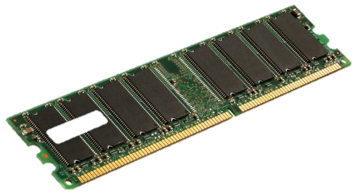
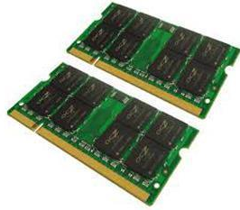
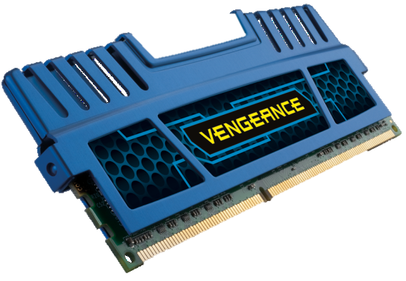
1.2 – Main Components - RAM
RAM (Random Access Memory) – There have been a few developments in Ram over the decades and most of this is down to size and speed. Ram size is measures in 128 or 256mb chunks and can be DDR1, DDR2 or DDR3 (3 being more expensive but faster), and the rule is the more memory a machine has, the faster it can store and process information.
They have a clock speed, the faster the clock speed, the faster the processing time. And this improves games, the more processing power that is taken from the CPU, the faster the CPU can deal with the instruction code of the game.
Unlike some hardware ram can be upgraded, simply remove the smaller one with a larger one but machines are limited to how many sockets there are for RAM.
Ram controls the CPU output and input, information is stored onto the Ram for processing and back from the CPU to Ram for dealing with and anything that helps the CPU is good. For Laptops the Ram is physically smaller but works in the same way.
People often mistake RAM with storage but RAM has no moving parts and does not overheat or break easily.

Slide 12
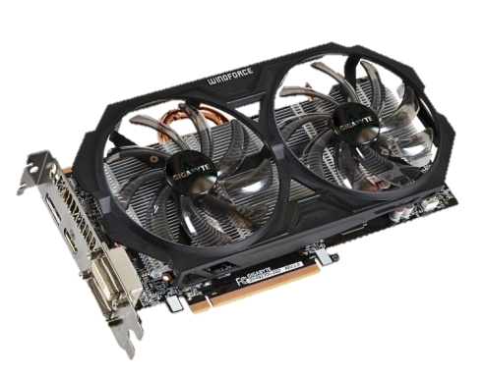
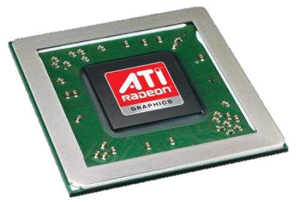
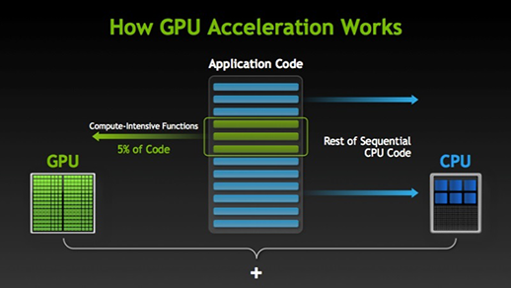
1.2 – Main Components – Video Card
Video Graphics cards handle all of the visual data within a computer, interpret it and display it via a VDU. Components on a Graphics card include:
GPU – Graphical Processing Unit is a dedicated microprocessor making calculations in order to display both 2D and 3D graphics.
Motherboard interface – This is the method of connection and transfer of information between the motherboard. These include PCI, AGP and PCI express.
Video BIOS - basic program that governs the video card's operations and provides the instructions that allow the computer and software to interface with the card.
Video memory – if the card is integrated onto the mother board it may use the computers RAM, otherwise it will have a dedicated amount of memory for use for storing other data as well as the screen image such as object co-ordinates.
Random Access Memory Digital-to-Analogue Converter – This coverts the digital signals produced by the computer processor into an analog signal which can be understood by the computer display
Output connectors – this is how the graphics card connectors to the VDU. This can include DVI, HDMI and component.
Cooling device – Video cards may use a lot of electricity, which is converted into heat. If the heat isn't dissipated, the video card could overheat and be damaged. Cooling devices are incorporated to transfer the heat elsewhere. Three common methods are heat sink, fan or water block.

Slide 13
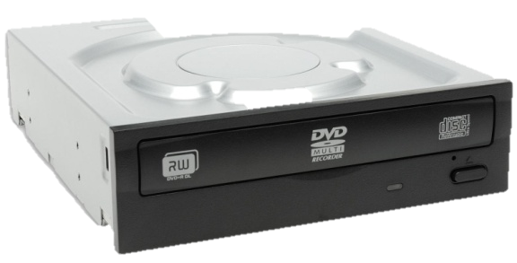
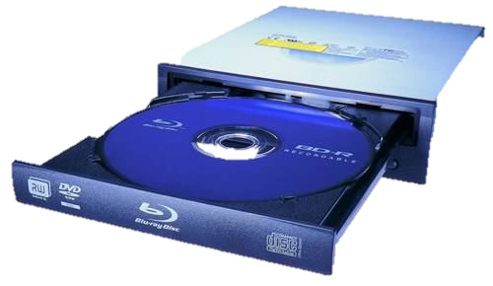
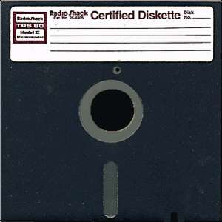
1.2 – Main Components – Optical Drive and Media
Optical Drive - First there was CD, 700MB, then DVD, 4400MB, now Blu-Ray. These are still not enough to back up a network drive but they are very useful as timed backups. All systems except Thin Client come with these as standard, they run off the IDE cable to the motherboard and act like a separate hard drive, taking a drive letter. Only certain Drives are RW, rewritable, but disks are so cheap that most people do not bother. This is a big step from the 3.5” and the 5.25” drives that were prevalent until 1999.
Optical media – These are more common now for network storage, capable of saving 120gb on one drive for a complete backup, takes an hour on a standard network to copy down to, can be carried away, and then reused, deleted like a memory stick and resaved.
Network managers tend to use these as a medium because of their reliability, set it running, leave it, take it away when done. Sizes of these vary again with price. They are not as easily accessible for home use like memory sticks or USB because they take time to archive and search.

Slide 14
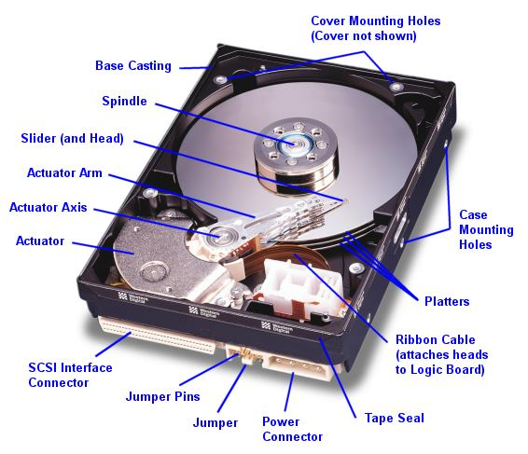
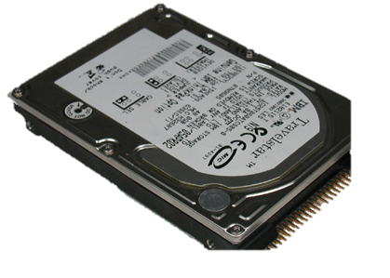
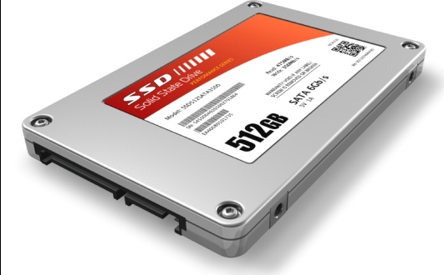
1.2 – Main Components – Hard Disks
Hard Disk - There are two sizes of hard drive for a PC, 2.5” for a laptop and 3.5” for a full machine. This has been the de facto standard since PC’s first came out. The original PC hard drive on home computers were a massive 20mb. But with operating systems starting at MS Dos 3, all you needed was 2mb for operating system storage. Word processors were 4mb, spreadsheets another 1mb leaving a massive 13mb for games and file storage. Doom, the most popular PC game ever, installed onto 5mb and could only run off the hard drive. So you played Doom or you played something else. These all used an IDE standard, the same connectors on the PC for linking up the Hard Drive to the motherboard.
Speed differentiation came into play, hard drive speeds of 5300 rpm, increased to 7200 rpm, and hard drives grew in size exponentially. 80mb became 120, then 200, 320, 500 and then a massive 10gb by 2000. Now the standard hard drive with a new PC is 250gb but 1.5 terabyte ones are available for home use at affordable prices. The faster the hard drive, the quicker the loading speed. For games this meant installing huge numbers of games on one machine at a time.
The new standard is SATA which is faster than IDE and easier to install allowing the use the daisy chain multiple drives onto a PC.

Slide 15
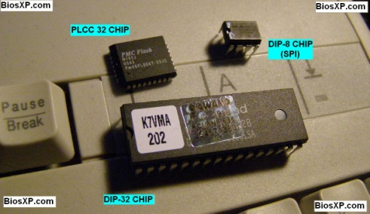
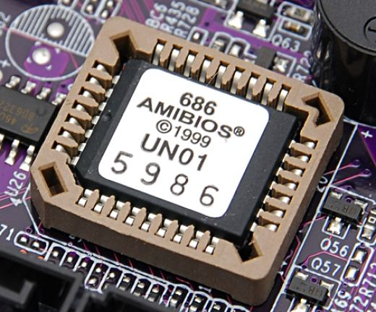
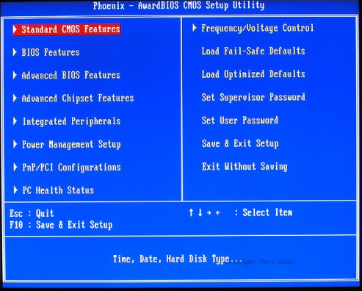
1.2 – Main Components - BIOS
BIOS – Built in operating system is a small battery linked to the core of the motherboard that tells a computer what it is, what CPU, what hard drives, what kind of motherboard, where the connectors are, what time of day it is and what standard devices are connected on the inside like Hard Drives and CD’s. All computers have one but they seem the least of things.
The two most common types are Phoenix and Ami, they contain a battery life of at least 3 years and contain several pages of important information, specifically hard drive configurations and IRQ allocation. Operating systems can override the BIOS but this takes extra time and can lead to IRQ conflicts.
Q1 - How many of those parts do you find in a Laptop?
Q2 - How many of those parts do you find in a Tablet?

Slide 16
1.3 – Different Operating Systems
Os’s – 2 different kinds of Operating system and 3 different OS’s that we should be aware of. The purpose of all Os’s is to:
Control the operation of the input, output and backing storage devices
Supervising the loading, running and storage of applications programs.
Dealing with errors that occur in applications programs
Maintaining security of the whole computer system.
Maintaining a computer log (which contains details of computer usage)
Computer users need to be able to communicate with the OS, this is called the “User Interface”. There are 2 main types of computer interface, Command Line Interfaces (CLI’s) and Graphical User Interfaces (GUI’s)
Activity – Research with evidence the changes in the Microsoft Interface from DOS to Windows 10.
The things a computer does when you switch it on Why the machine takes so long to start How the computer knows how to display those little icons. The in-built repair programs. How the computer always seems to work and know what is happening. Loading times

Slide 17
1.3 – Operating Systems - Command Line Interface
Os’s – A CLI (command line interface) is a user interface to a computer's operating system or an application in which the user responds to a visual prompt by typing in a command on a specified line, receives a response back from the system, and then enters another command, and so forth, for example opening or closing a file.
The user therefor has to learn a number of commands just to carry out basic operations which is slow having to type them all in every time the command need to run.
However the advantage of CLI is that the user is in direct communication with the computer and is not restricted to locked down options.
1. SQLPrepare(hStmt,
2. ? (SQLChar *) “INSERT INTO tableB SELECT * FROM tableA”,
3. ? (SQL_NTS):
4.? (SQLExecute (hStmt);
As you can see the above statement shows how complex it is just to carry out a fairly straightforward operation using CLI.
How complex it looks The films you have seen that has someone typing in code How hacking works. Why the CLI is still there in Windows after 10 generations. Why an Apple is different and where is the CLI in an Apple. Does a Tablet have a CLI. What are Computing Courses

Slide 18
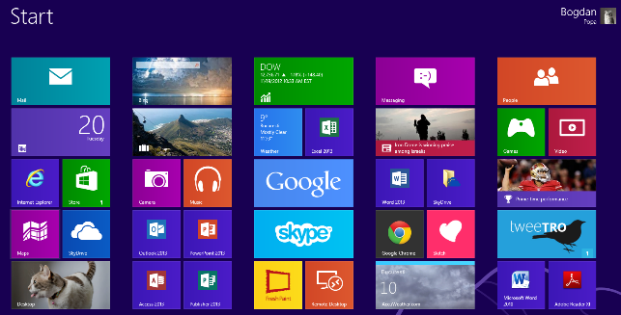
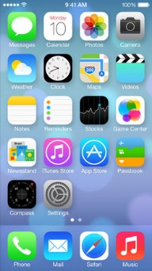
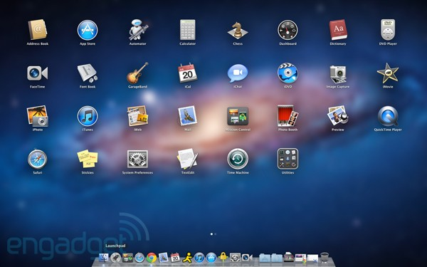
1.3 – Operating Systems - Graphic User Interface
Os’s – A GUI (Graphic User interface) is a user interface that you are looking at right now, often called WIMP (Windows, Icons, Mouse and Pointers) It allows the user to interact directly with the programs and devices using pictures (Icons) rather than having to type in a number of commands. For example the code on the previous slide could have been down with one click of a buttons.
WIMP is the most common, you use the mouse to select the application and double click. It opens in a window, you can open several applications and jump between them. The GUI manages these through the interface, called Task Manager.
In recent years devices with touch screens use post-WIMP interaction and this allows actions such as pinching and rotating which is difficult with a mouse.
How you can customise the way it looks How the Icons are designed to make it easier to find The variety of different shapes. The use of Windows Flag Key. How you can change your icons, mouse, screen, saver. Folders and subfolders to clear up the mess. Loading times.

Slide 19
1.4 – Types of Computers – PC’s
There are many different types of computer in existence, we will focus on the most common ones.
PC – A PC/Desktop usually refers to a general purpose computer which is made up of separate monitor, keyboard and mouse and processing unit (Base) The term PC comes refers to a system which is IBM compatible, rather than Apple and sometimes gets confused with a Laptop.
Advantages – Spare parts and connections tend to be standard reducing the price.
Desktops have to be a better specification (e.g. faster processor) for a given price (often due to size and construction restraints of a laptop)
The large case allows for heat dissipation.
Disadvantages – They are not portable since they are made up of separate components.
All the components need to be hooked up with wiring, which can be quite complex and clutters up the desk space.
Because they are not portable, it is necessary to copy files when you want to do work elsewhere.
Better and bigger screens Can have multiple internal hard drives. Only need to change one thing to make it faster. Playing games Desk space (footprint). Noise levels Clutter, cables, leads, inputs and outputs. Not environmentally friendly when disposing of.

Slide 20
1.4 – Types of Computers - Laptops
Laptops (or Notebooks) – This refers to a range of computers where the monitor, keyboard, pointing device and processor are all together in one unit, making them more portable.
These have become the most common type of Computer in the home but not at work. Most companies prefer their staff not to be away from their desks. Over the decades of use, they have grown more powerful and in some ways smaller with better battery life.
Advantages – Portable since all the devices are combined.
Low Weight (to aid portability)
Low power consumption (therefor longer battery life)
A processor that does not generate too much heat (cooling is vital)
Good for sampling and sensoring.
Disadvantages – Since they are portable, they are easy to steal.
Limited battery life so the user has to carry a power supply.
Keyboards and pointing devices can be difficult to use.
Heat dissipation is more difficult due to the structure of the laptop.
Graphics on the screen will not be as good as a standalone. (e.g. Motion blur)
Restricted on the amount of devices that can be added at one time.
Which one you would prefer and why. The limitations in game playing or TV watching. How many you have broken by accident. Spills and how expensive it will be to repair compared to a PC. Desk space (footprint). Noise levels Lack of clutter, cables, leads, inputs and outputs.

Slide 21
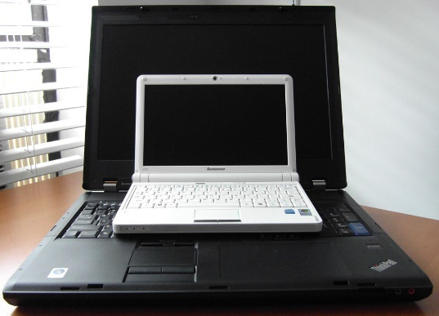
1.4 – Types of Computers - Netbooks
Netbook – This is a term used to describe a computer that can almost fit into your hand and is a smaller version of a Laptop. They used to be knows as Palmtop computers but this term now generally applies to much smaller devices which use touch screens and often a stylus to key in data.
Advantages – They have many of the features of Laptops therefor have similar advantages.
They are more portable and use less battery life die to their limited functionality.
Tend to have no moving parts (therefor better battery usage).
Disadvantages – They do not have optical drives (CD, DVD) which makes installing difficult.
The keyboards are only about 80% the size of Laptop keyboards.
They lack some of the features found in larger machines, principally due to the size constraints.
Cheaper to purchase due to their limited capacity.
Small and easy to put away Comparison to tablets. How a school could use them in a class. Smaller screen so more difficult to read. Desk space (footprint). Noise levels Lack of clutter, cables, leads, inputs and outputs. Screen displays web pages in a similar way to a computer and not a tablet.

Slide 22
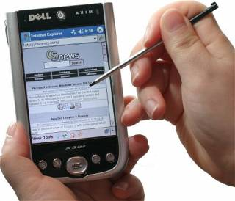
1.4 – Types of Computers – PDA’s
Personal Digital Assistant (PDA) – These are small handheld computers that usually come with a touch screen that is activated using a stylus. Data (e.g. text) is entered by using a keyboard that appears on the touch screen. Originally these devices were used as personal organisers but their use has expanded to include new generation mobile phones, data loggers, satellite navigation systems (GPS), personal fitness measures etc. Many PDA’s now have a basic database, word-processing and spreadsheet facilities.
Advantages – They can be used anywhere because of their size.
They are very lightweight and more portable than laptop computers.
They can be used to sign for packages because of the stylus design.
They can have GPS or RFID tracking to measure the delivery time of drivers.
Disadvantages – It is difficult to enter text quickly.
They have very limited capabilities due to the software and the operating system used.
Small and easy to put away Comparison to tablets. How a school could use them in a class. Smaller screen so more difficult to read. Desk space (footprint). Noise levels Lack of clutter, cables, leads, inputs and outputs. Screen displays web pages in a similar way to a computer and not a tablet.

Slide 23
1.4 – Types of Computers - Mainframes
Mainframe Computers – This is a term for large, very powerful, computer systems. The name comes from the days when the individual components were housed in large (room sized) frames.
Uses – Their main purpose is to run commercial applications, such as banking and insurance, where large amount of data needs to be processed each day. Their main features of these include:
They can have several CPU’s each and huge amounts of storage capacity.
They have very fast processor speeds and huge internal memory.
They can support multiple operating systems.
They often operate using time sharing or batch processing (discussed later)
Advantages – Due to the above, they can do very large jobs which require large memories and very fast processing time.
They are used in Time-Sharing systems to allow users a time slice of the very powerful facilities afforded by a mainframe system.
They are capable of very large number crunching and deal with complex mathematical functions which are very time consuming.
Disadvantages – Mainframe computers need to be permanently housed in large rooms so they cannot be moved around.
They are very expensive to operate and maintain.
Activity – Research Colossus, Logic gates and its processing capacity compared to todays standards.
Render farms How long it takes to make a Pixar Movie. The difference in animations technologies. The Last Starfighter CGI sequence Cray XMP. How to cool them down What they will be like in twenty years. The amount of data we use now than 20 years ago and how fast it is growing.

Slide 24
1 – Exam Questions
Exam Questions
2016 – Specimen Paper
Tick true or false next to each of these statements.
[2]
 | True | False
Computer programs are examples of hardware.
A Command Line Interface is a form of operating system.
A tablet computer is larger than a desktop computer.
A compiler is an example of applications software.

